Slide 1
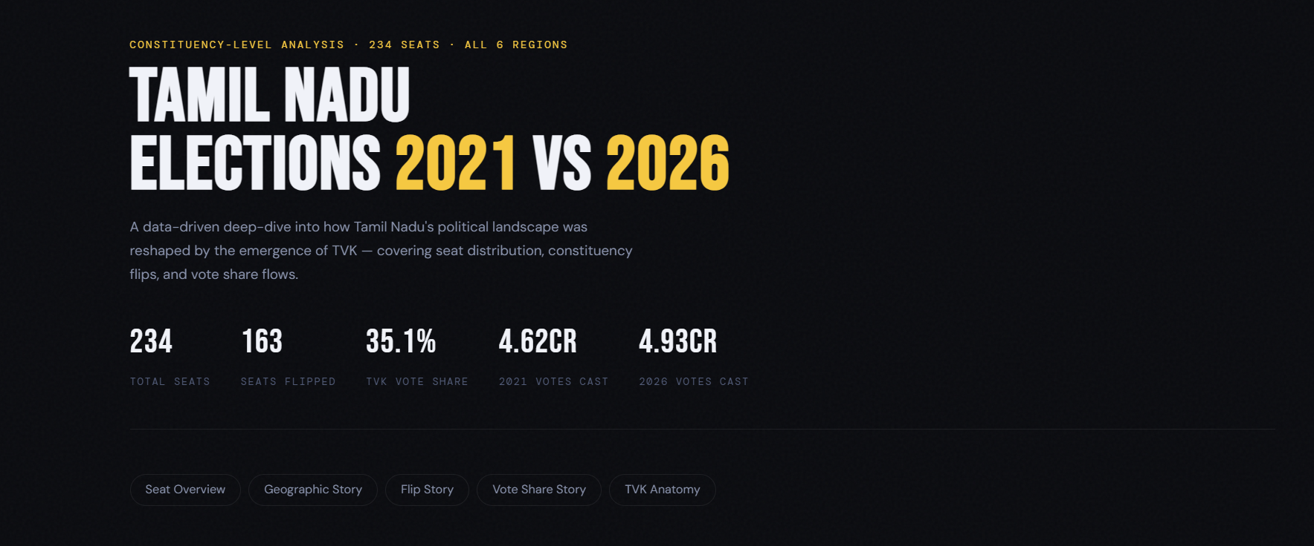
Tamil Nadu Assembly Election
2021 vs 2026
Decoding Tamil Nadu’s historic political realignment through interactive election analytics.
Built Using:
Power BI · Python · Plotly · Streamlit · Claude AI
Created By : Amit Kumar Mishra

Slide 2
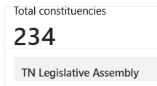
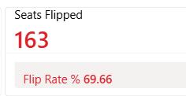
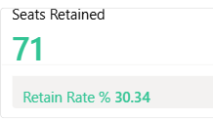
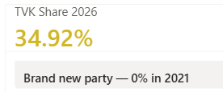
Understanding Tamil Nadu’s Political Transformation
Problem Statement :
The 2026 Tamil Nadu Assembly Election witnessed one of the most dramatic political transformations in recent history.
This project analyzes:
Regional political shifts
Constituency flips
Vote share redistribution
Emergence of TVK as a dominant political force
How did regional political dominance shift?
How many constituencies changed winning parties?
Where did TVK’s votes come from?

Slide 3
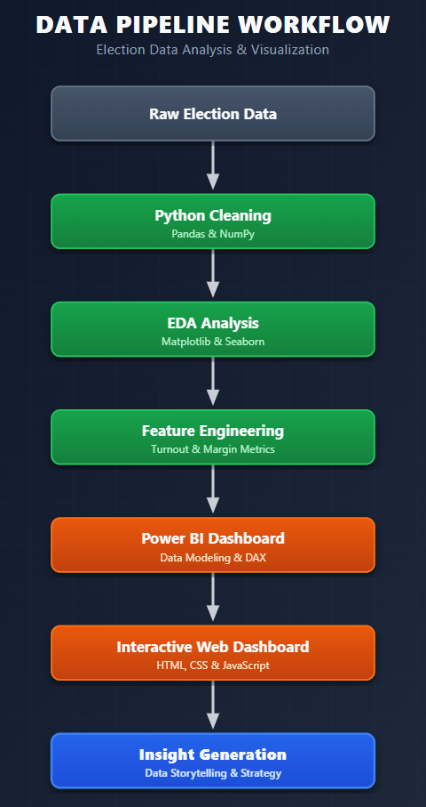

Data Pipeline & Analytical Workflow
Dataset Information
Election Commission of India (ECI)
2021 & 2026 Assembly Elections
234 constituencies
6 regional divisions
Constituency-level vote analysis

Slide 4
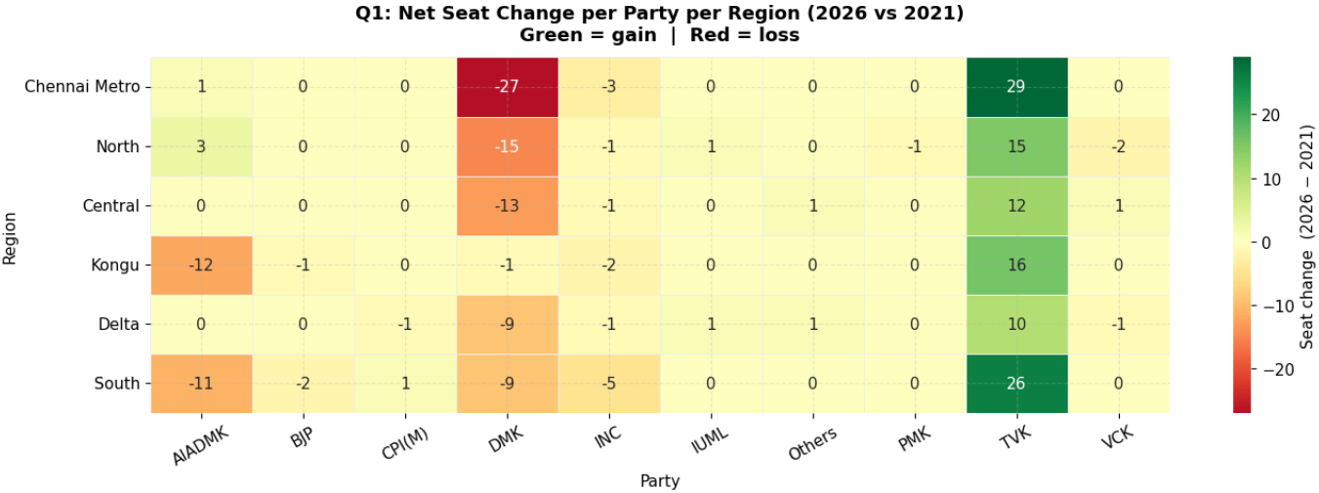
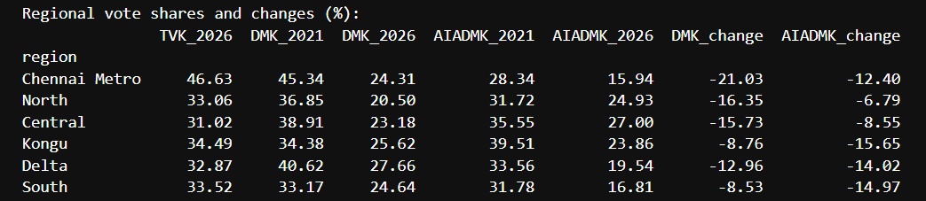
Exploratory Data Analysis

Slide 5
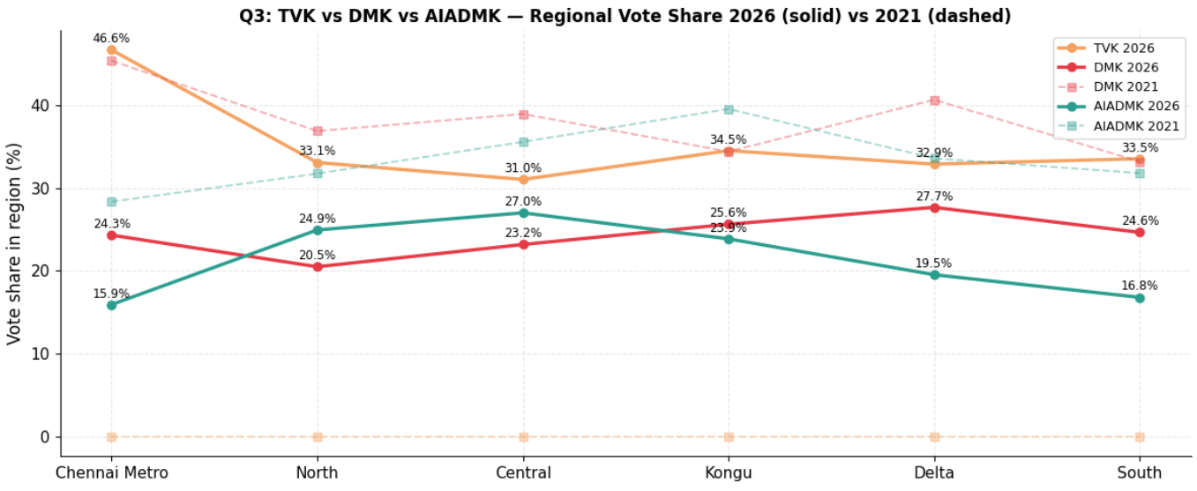

Slide 6
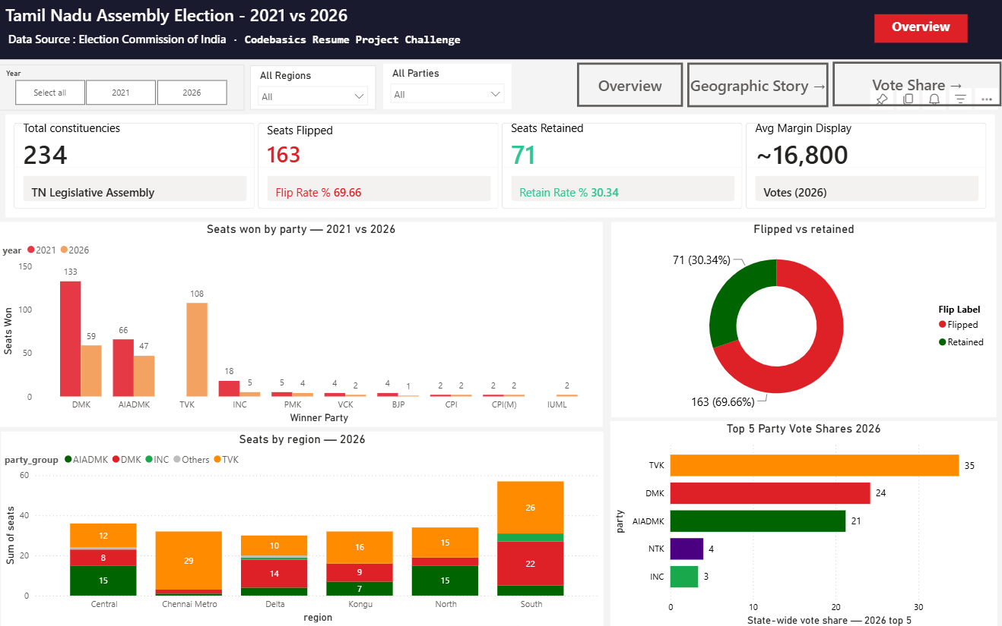
Interactive Election Intelligence Dashboard
Dashboard Features
Interactive filtering
Comparative analysis
Regional drilldowns
Constituency-level insights
Multi-page navigation

Slide 7
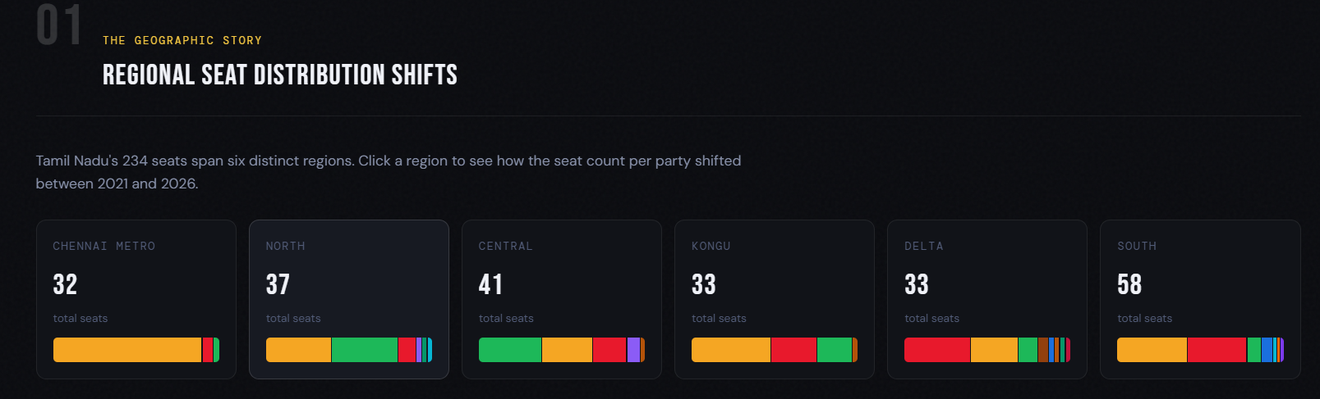
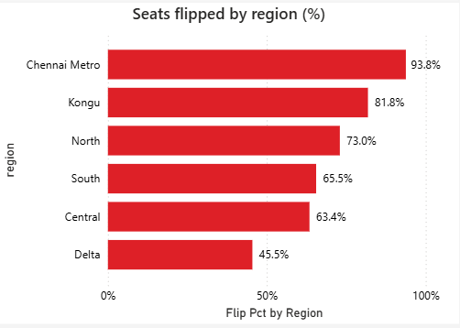
The Geographic Story
Key Insights
Chennai Metro recorded highest political churn
TVK dominated urban regions
Delta remained comparatively stable
Kongu witnessed AIADMK collapse
The 2026 election reflected a state-wide political realignment rather than isolated regional swings.

Slide 8
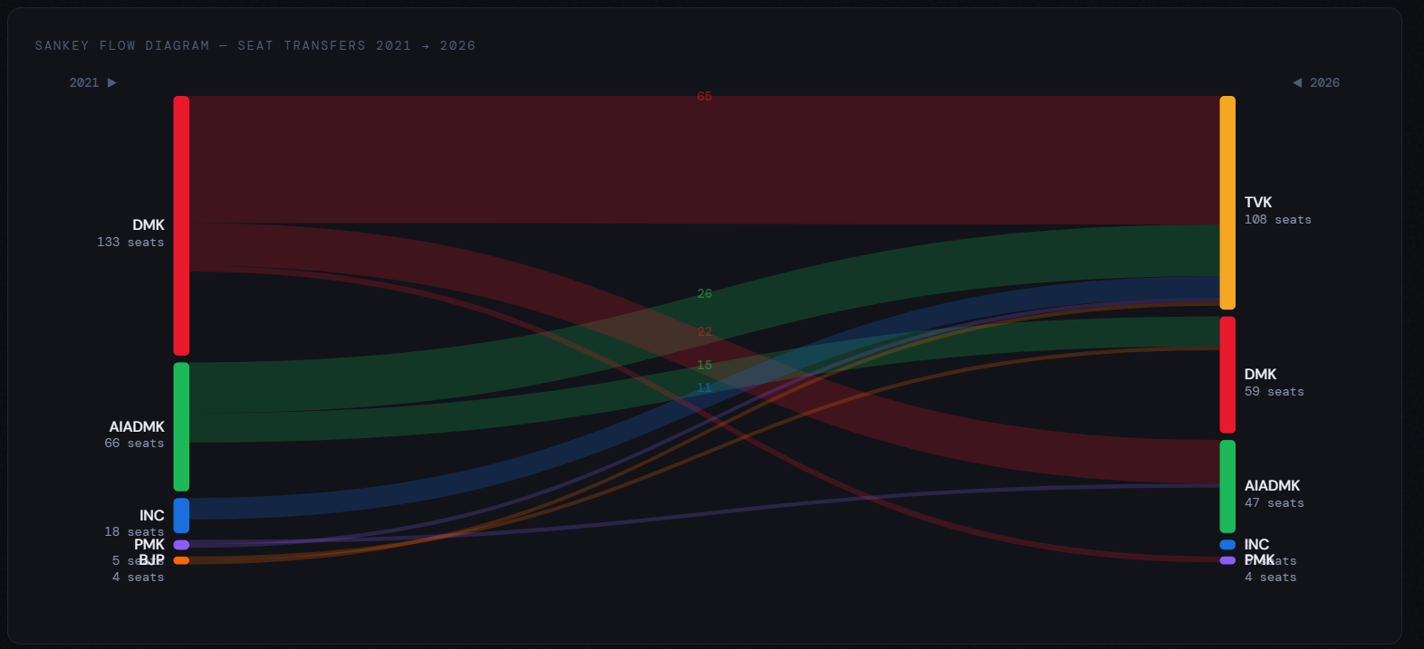
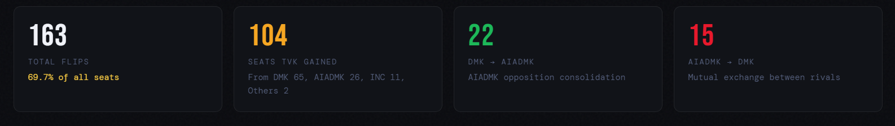
Massive Political Churn
65 seats shifted directly from DMK to TVK.
Nearly 7 out of 10 constituencies changed control.
Anti-incumbency became state-wide.

Slide 9
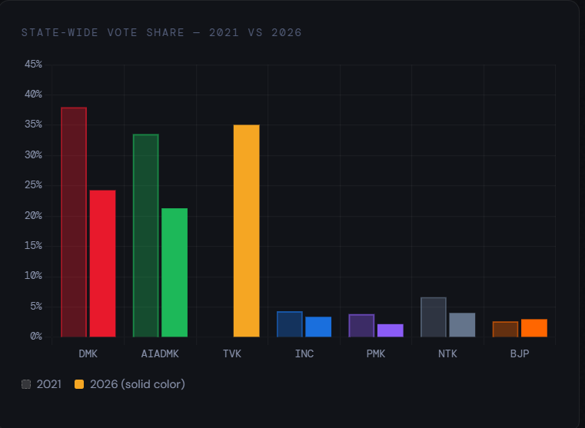
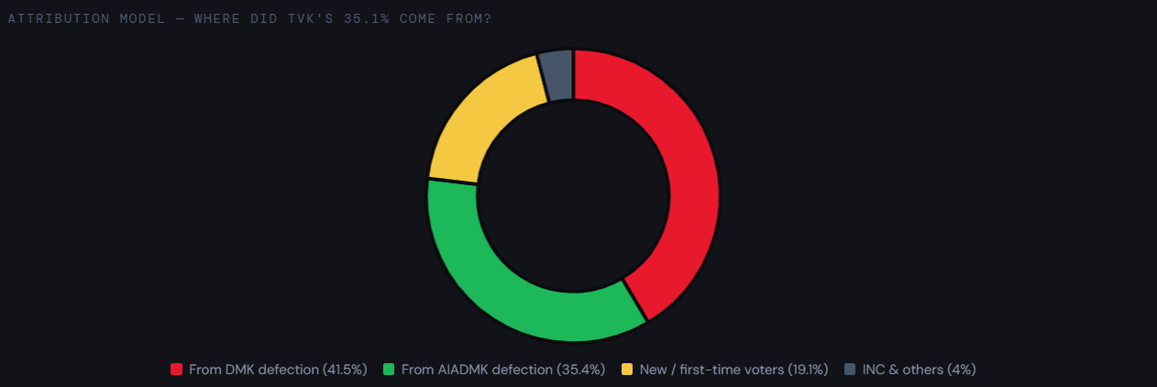
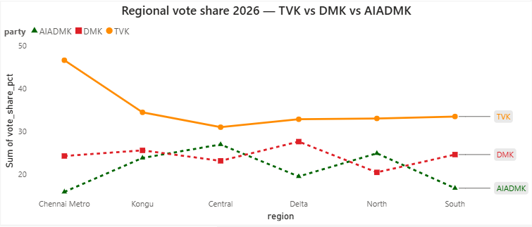
Where Did TVK’s Votes Come From?
TVK absorbed votes from both DMK and AIADMK
155 constituencies showed dual-party decline
Urban youth mobilization significantly increased turnout
Chennai Metro became TVK’s strongest zone
TVK consolidated anti-incumbent sentiment across multiple voter blocs rather than cannibalizing a single party base.

Slide 10
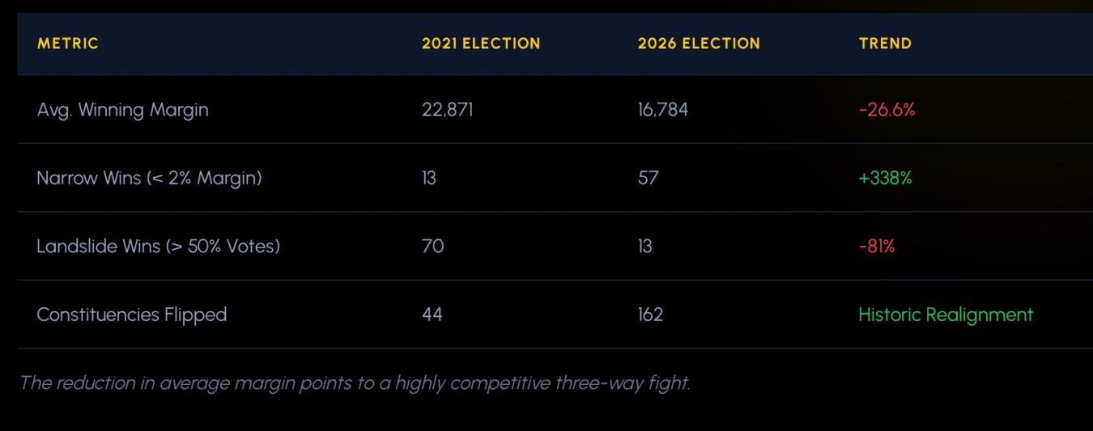
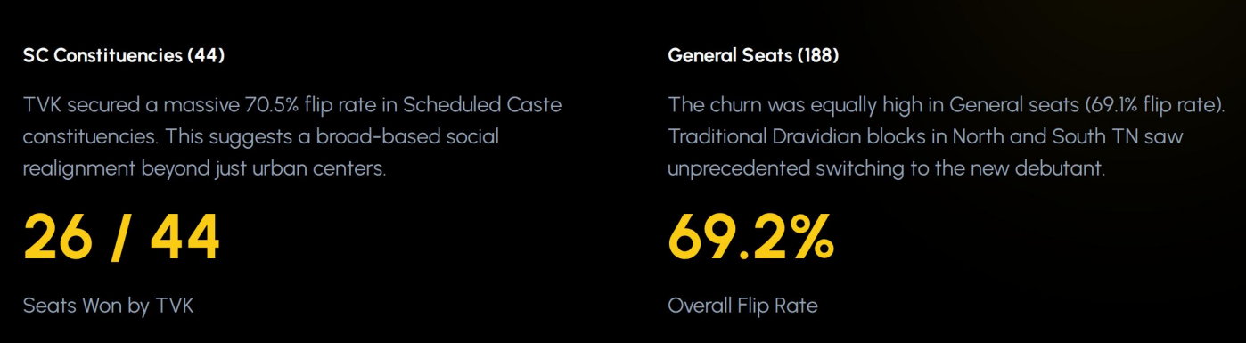
Intensity of the 2026 Election

Slide 11
The Future of Tamil Nadu Politics
FINAL TAKEAWAYS
Geographic Shift
State-wide regional realignment occurred
Historic Flip Rate
163 constituencies changed hands
Collapse of Legacy Vote Banks
DMK and AIADMK both saw double-digit decline
Rise of TVK
TVK emerged as a dominant new political force
The 2026 Tamil Nadu Assembly Election represents a structural political transition rather than a routine electoral cycle.
Built Using:
Power BI · Python · Plotly · Streamlit · Claude AI
Created By : Amit Kumar Mishra

Slide 12
THANK YOU

